Slide 1
Exterior in progress

Slide 3
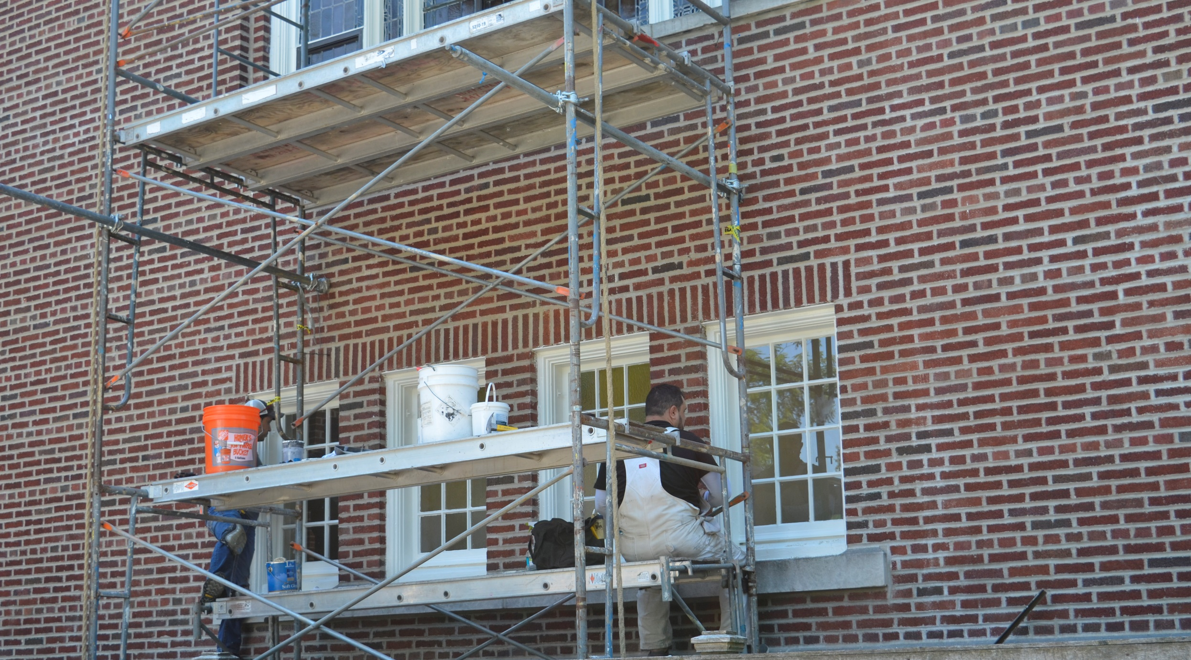

Slide 5
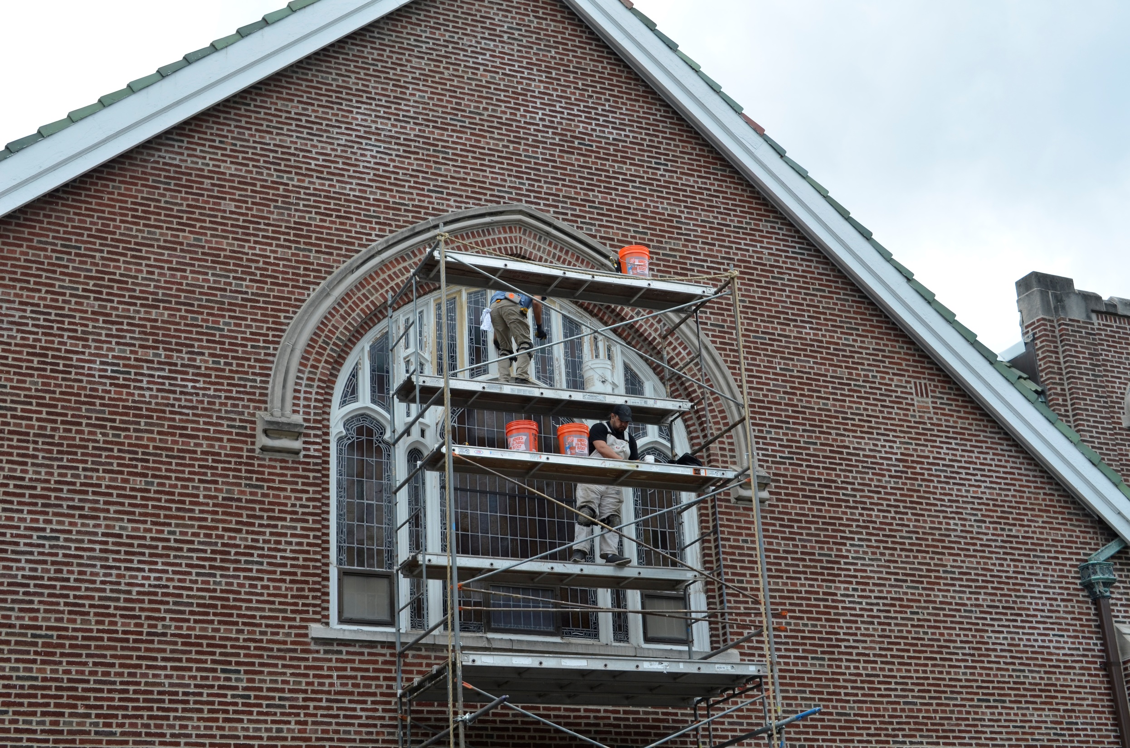

Slide 6
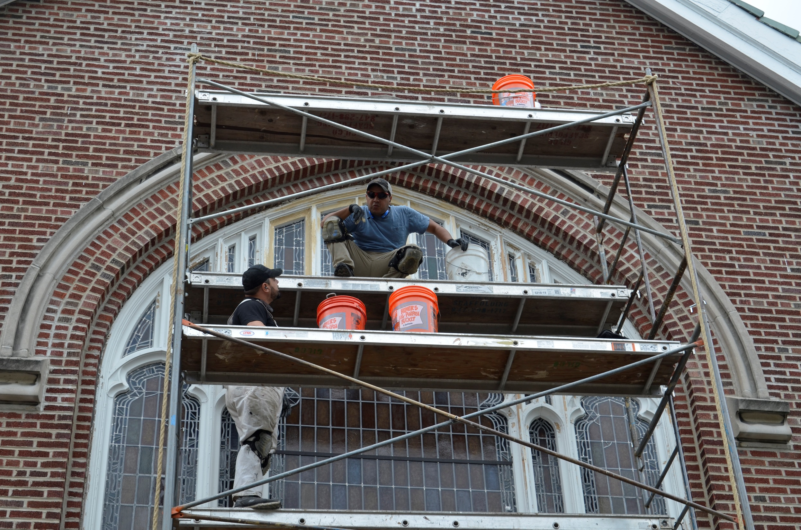

Slide 7
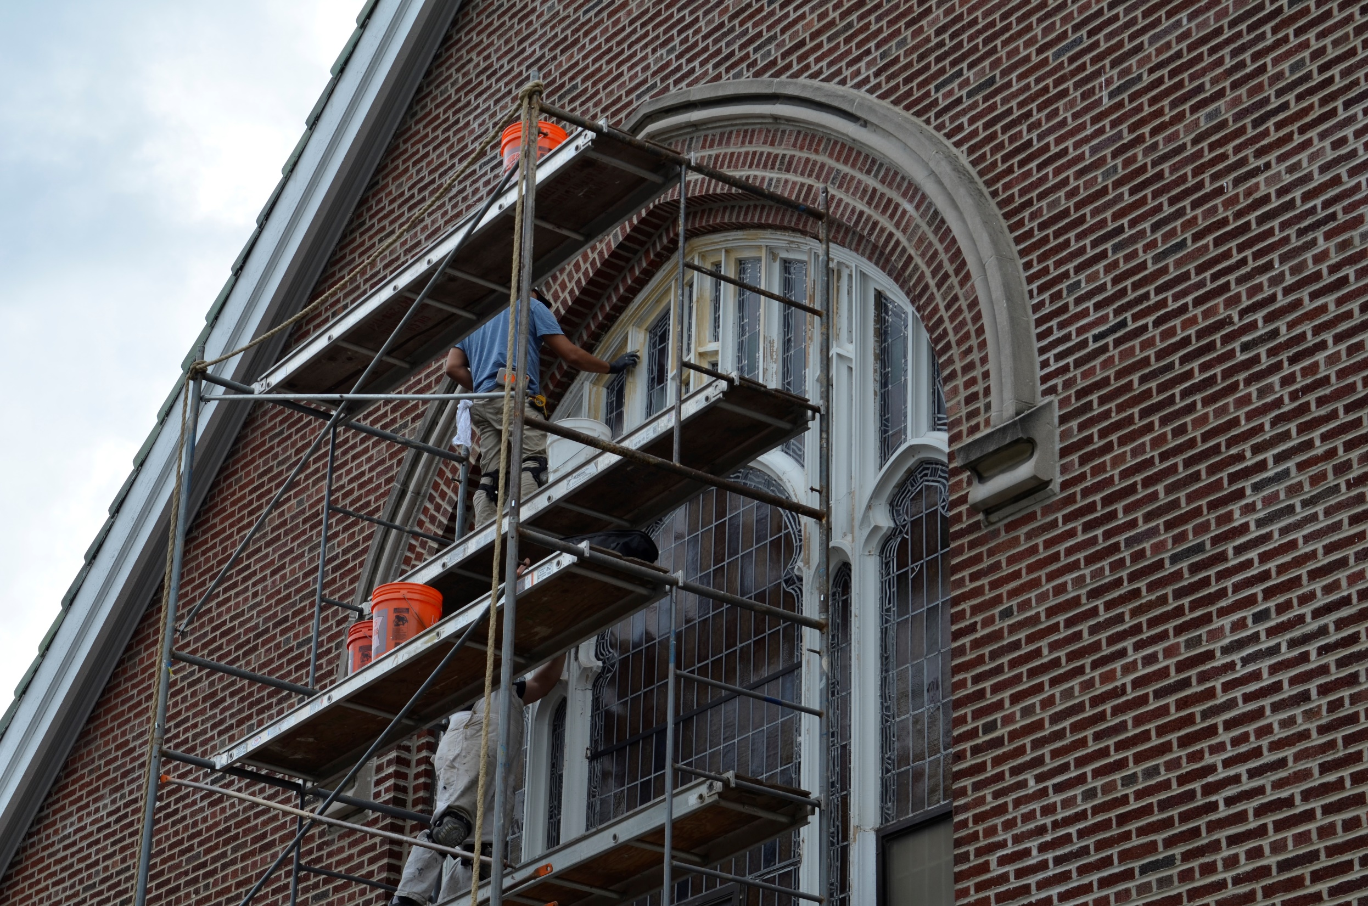

Slide 8
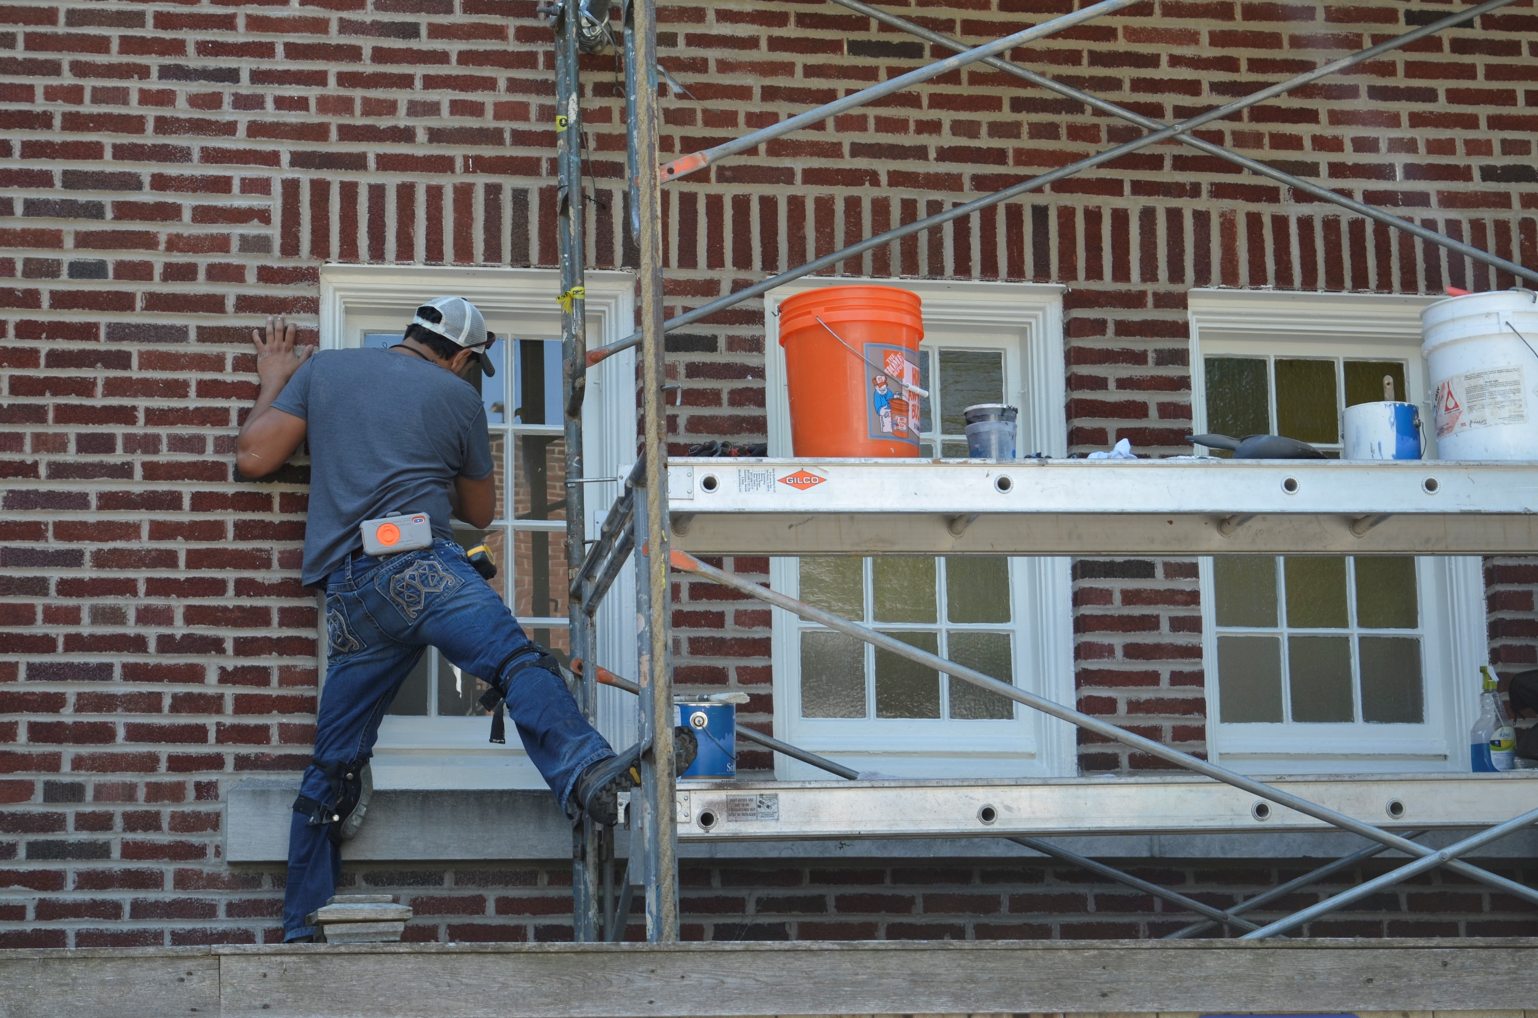

Slide 9
Before shots of warped and leaking windows – mostly from balcony

Slide 10
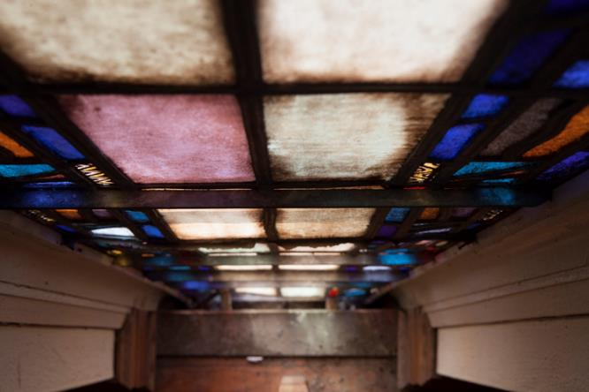
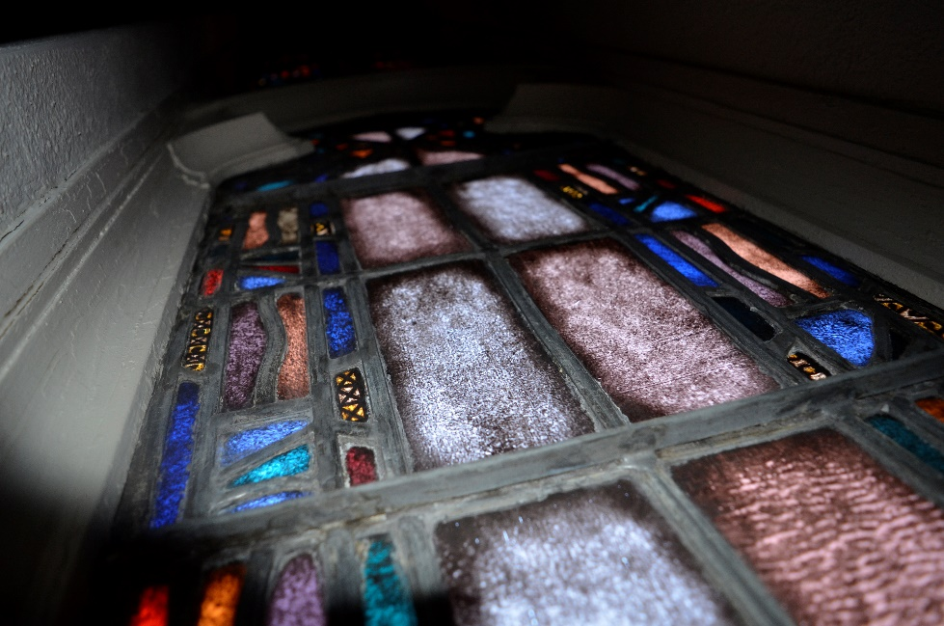
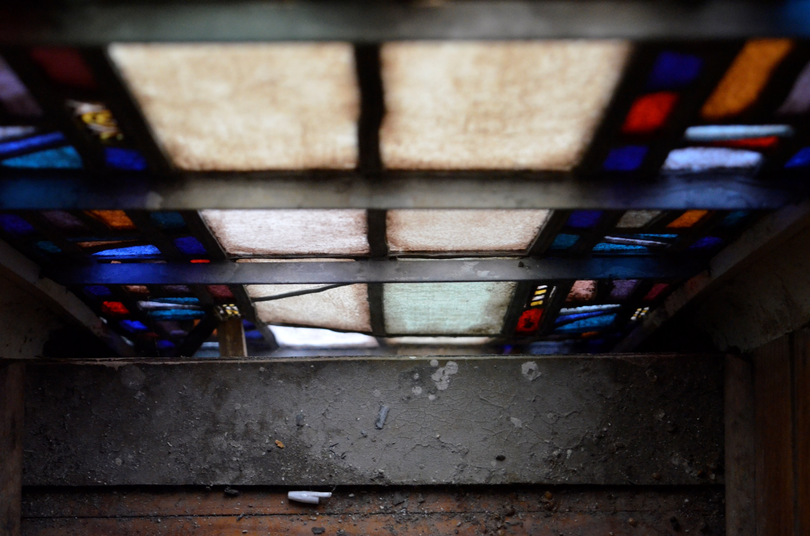
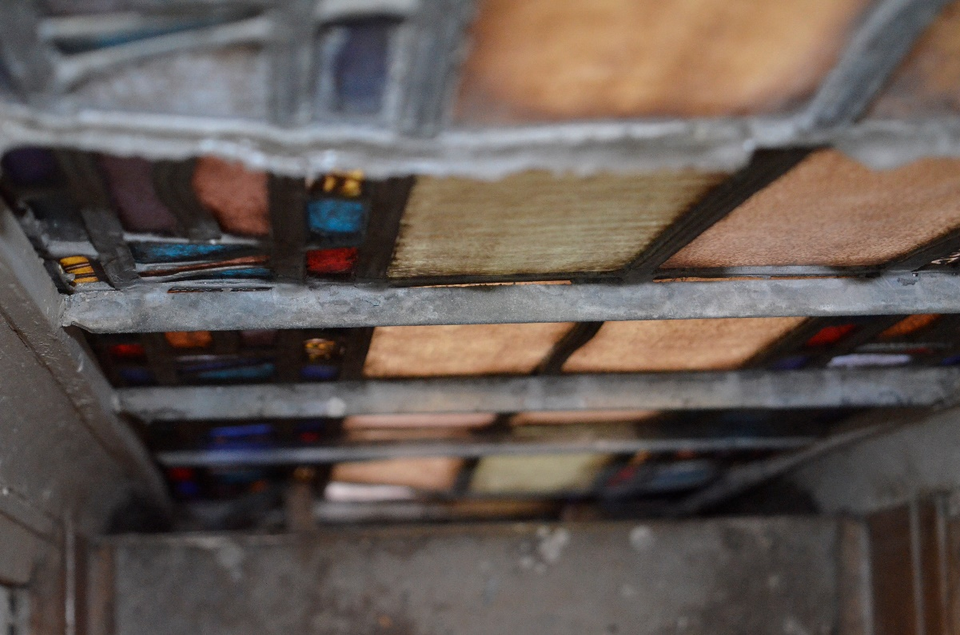

Slide 11
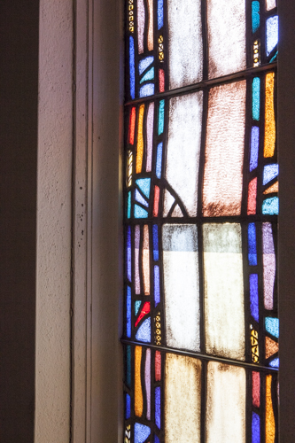
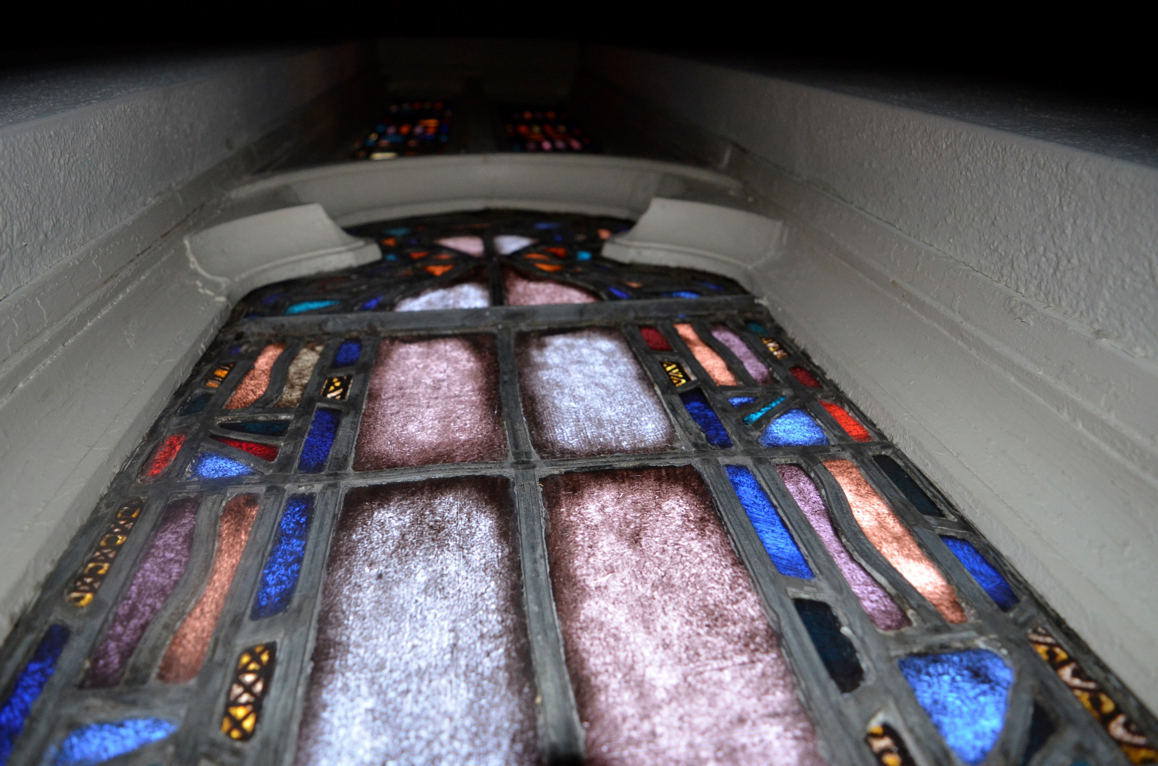
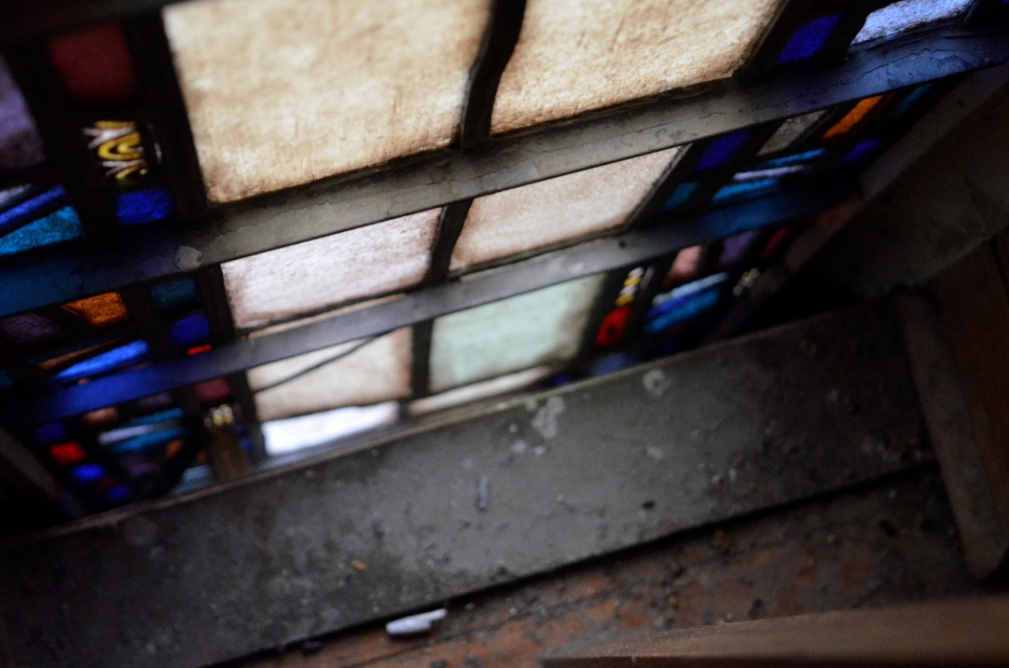

Slide 12
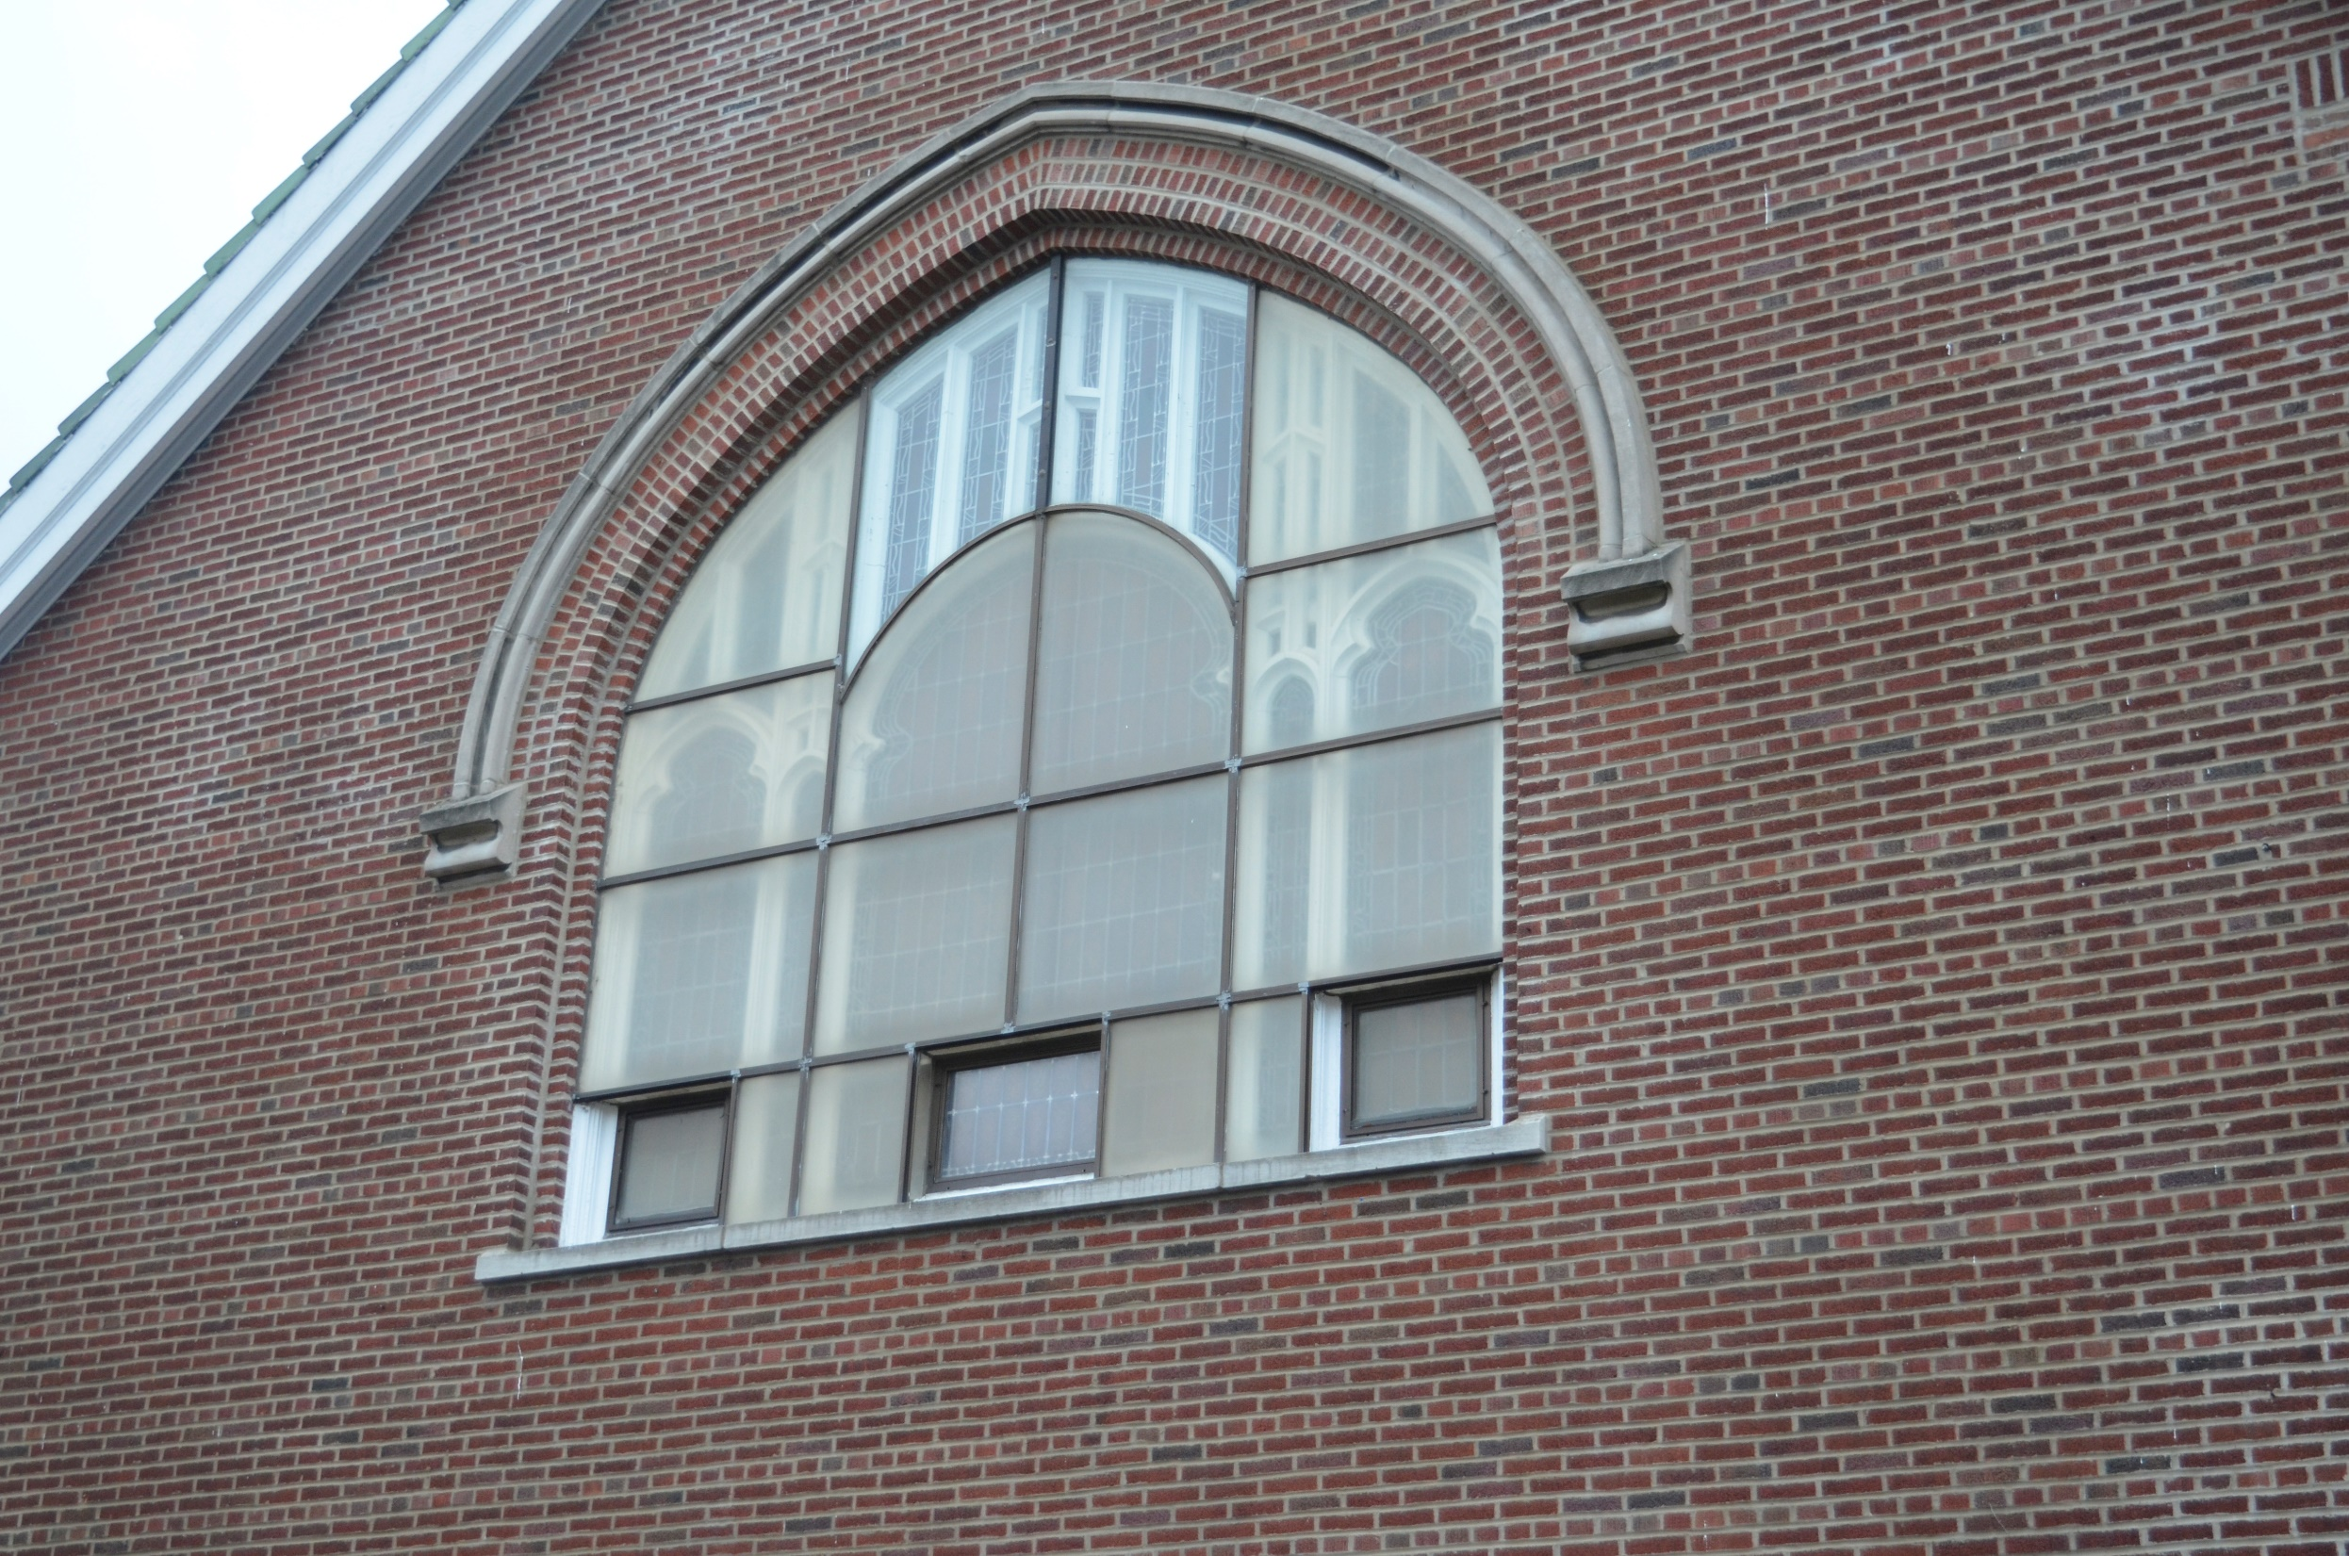
Old plexiglass turned brown – reduced light, looked dirty, retained moisture which ruined frames and deteriorated cement

Slide 13
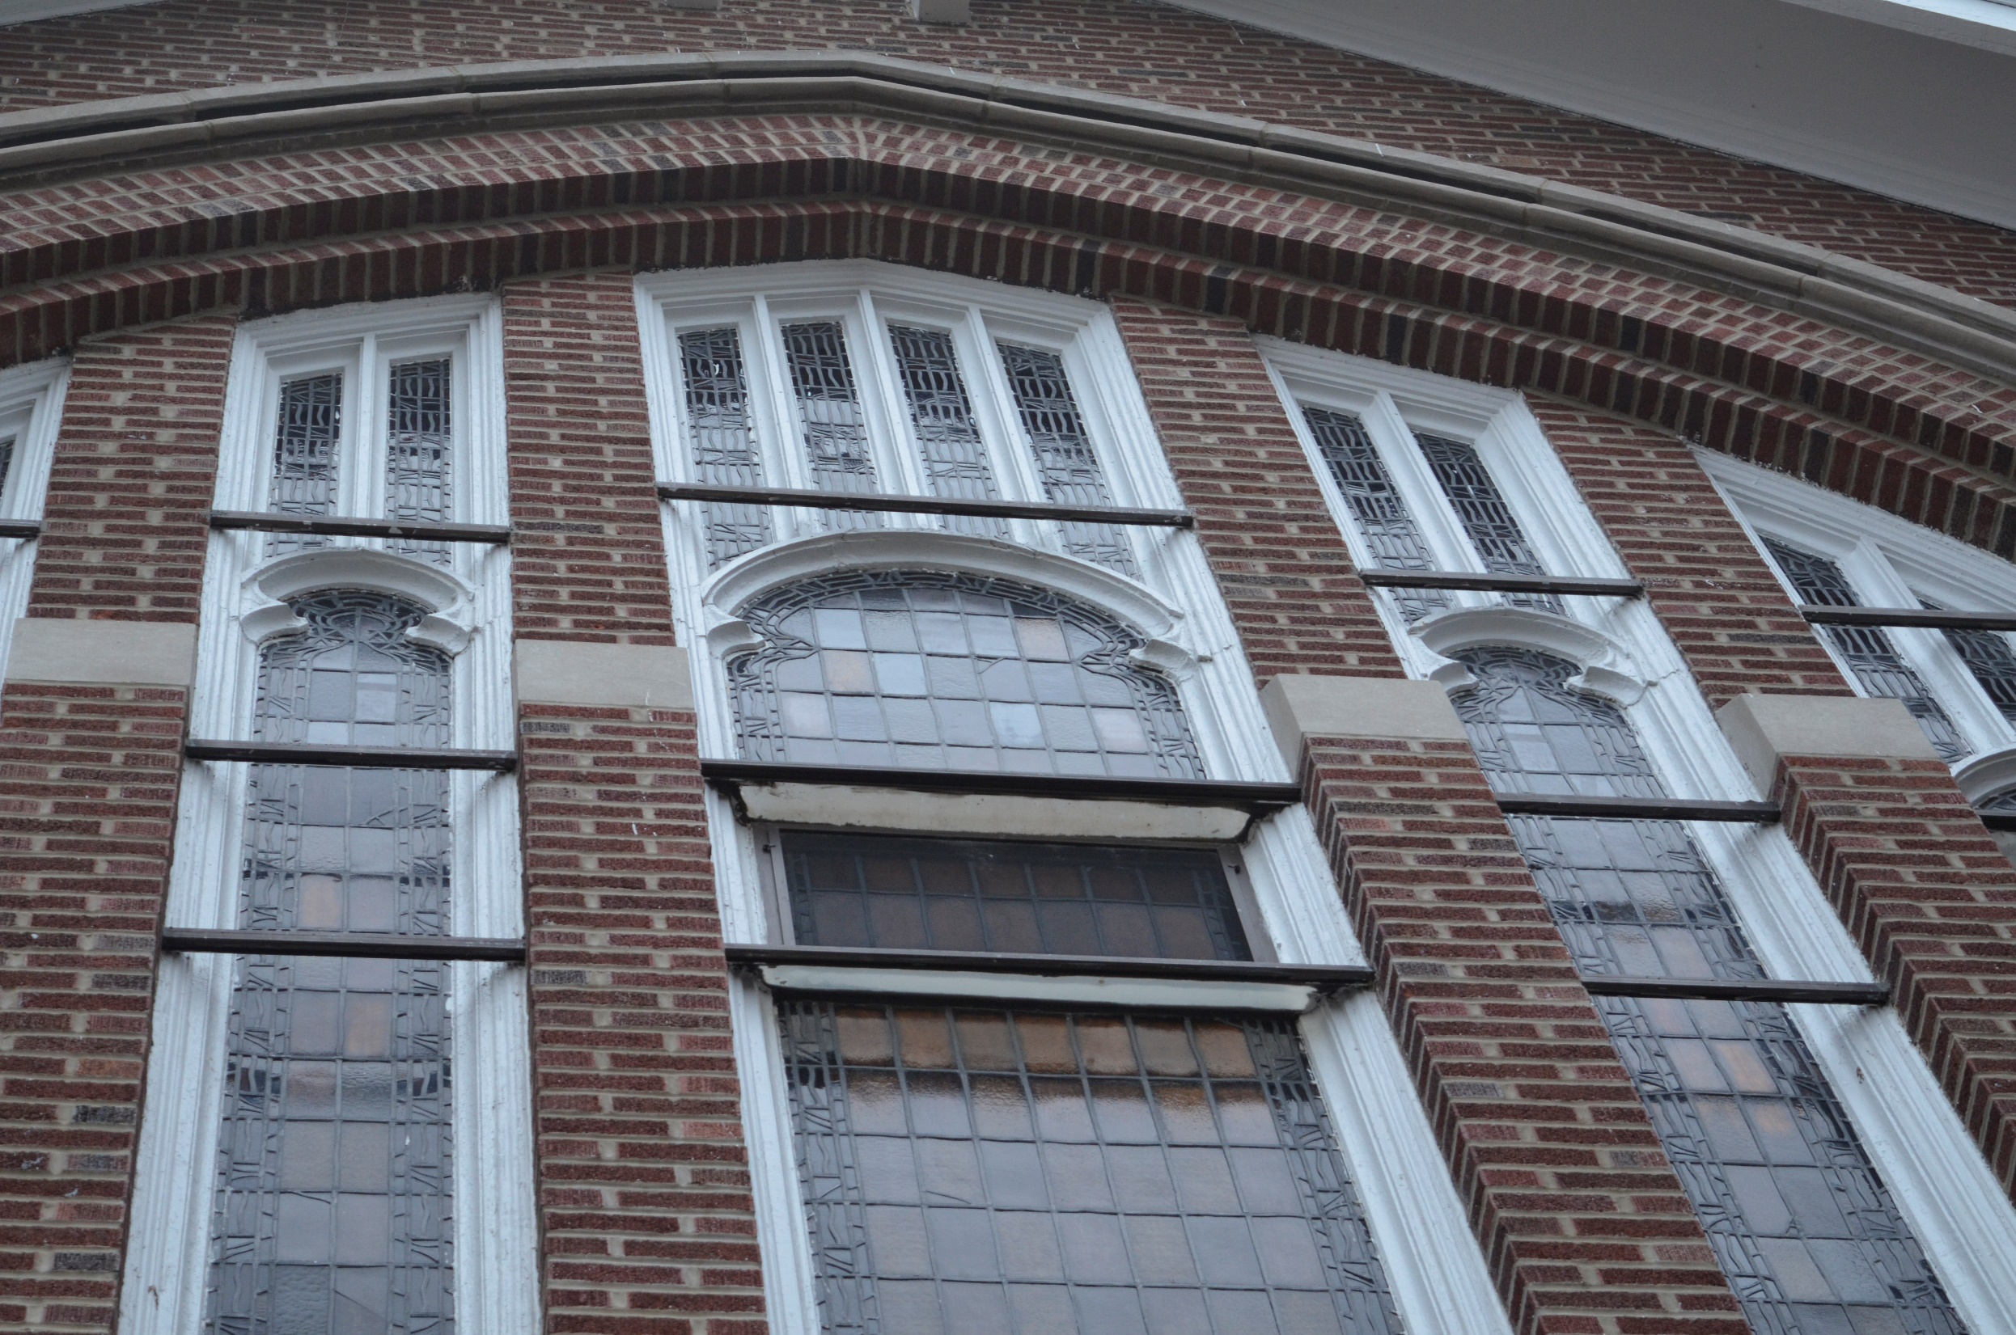
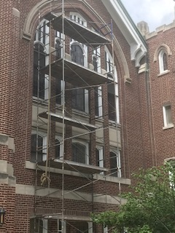
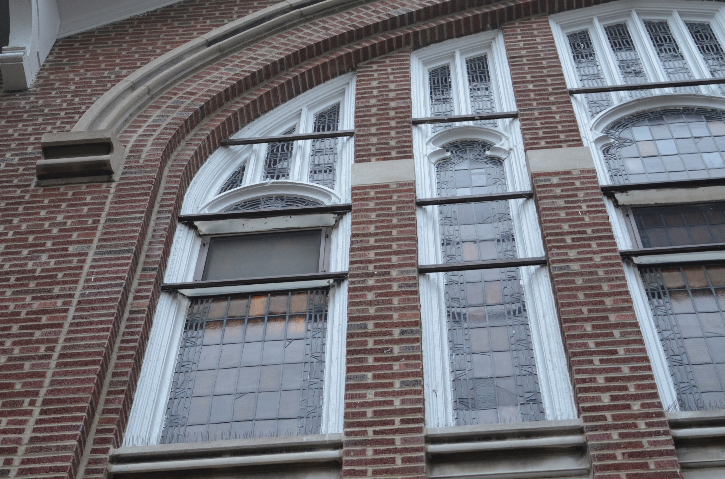
Stained glass windows with plexiglass removed for restoration

Slide 14
Window removed and taken to studios for work

Slide 15
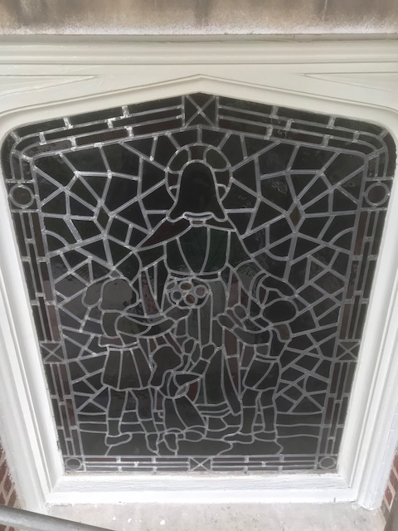
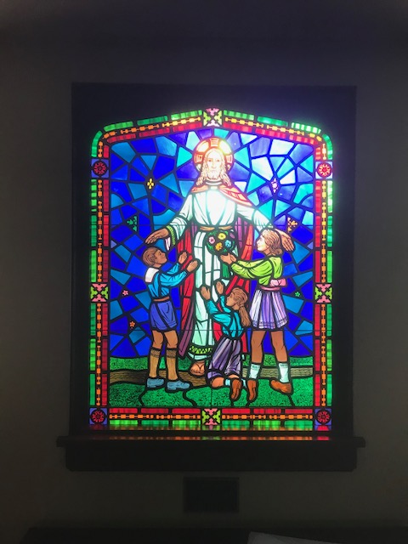

Slide 16
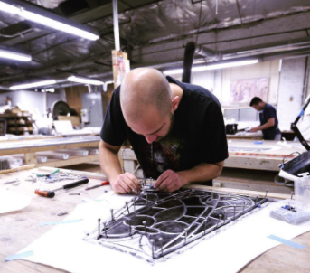
Craftsman at Daprato Rigali Studios working on restoring a window brought to the shop

Slide 17
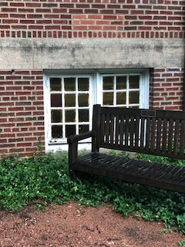
Double-hung window example – these were in bad shape

Slide 18
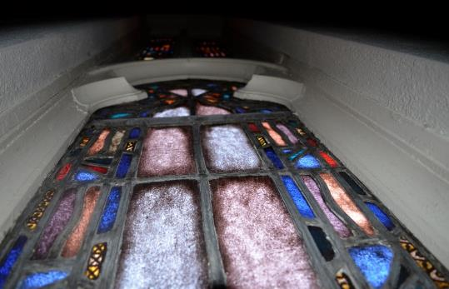
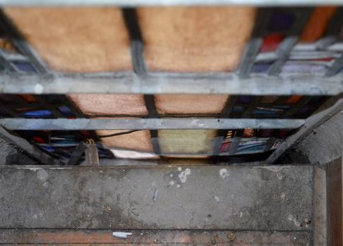
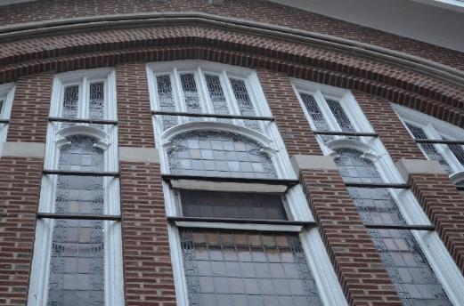
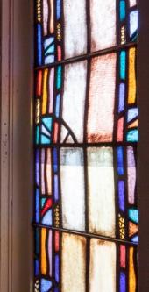
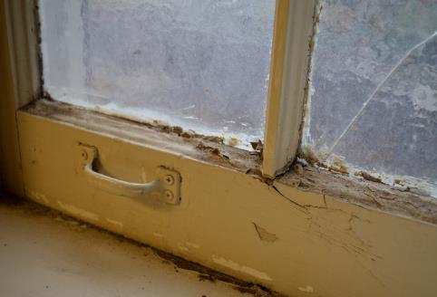
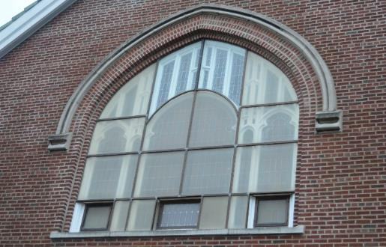
Let There Be Light…But No Leaks
We Like Our Glass Stained, But Also Sturdy And Strong
Pending Capital Project: Refurbish and repair all
stained glass windows - $64 K
Longer Term:
Gradually replace and / or refurbish all windows
Reserve Study Estimates:
$202 K over 10 years
Sustainability:
Energy-efficiency, preservation
Admin. Committee Leaders: Lombardo
In general, frames in good shape… glass still colorful and vibrant
Stained glass loose within leading, requiring new cement to seal
Rebuilding warped and buckled panels will require removal to repair
Stained glass restoration to be performed by craftsman with experience back to 1860
Pilgrim Hall windows deteriorating and leaking air into the building
Dark, discolored plexiglass removed from 50% of stained glass windows. Time to complete the job.

