Slide 1

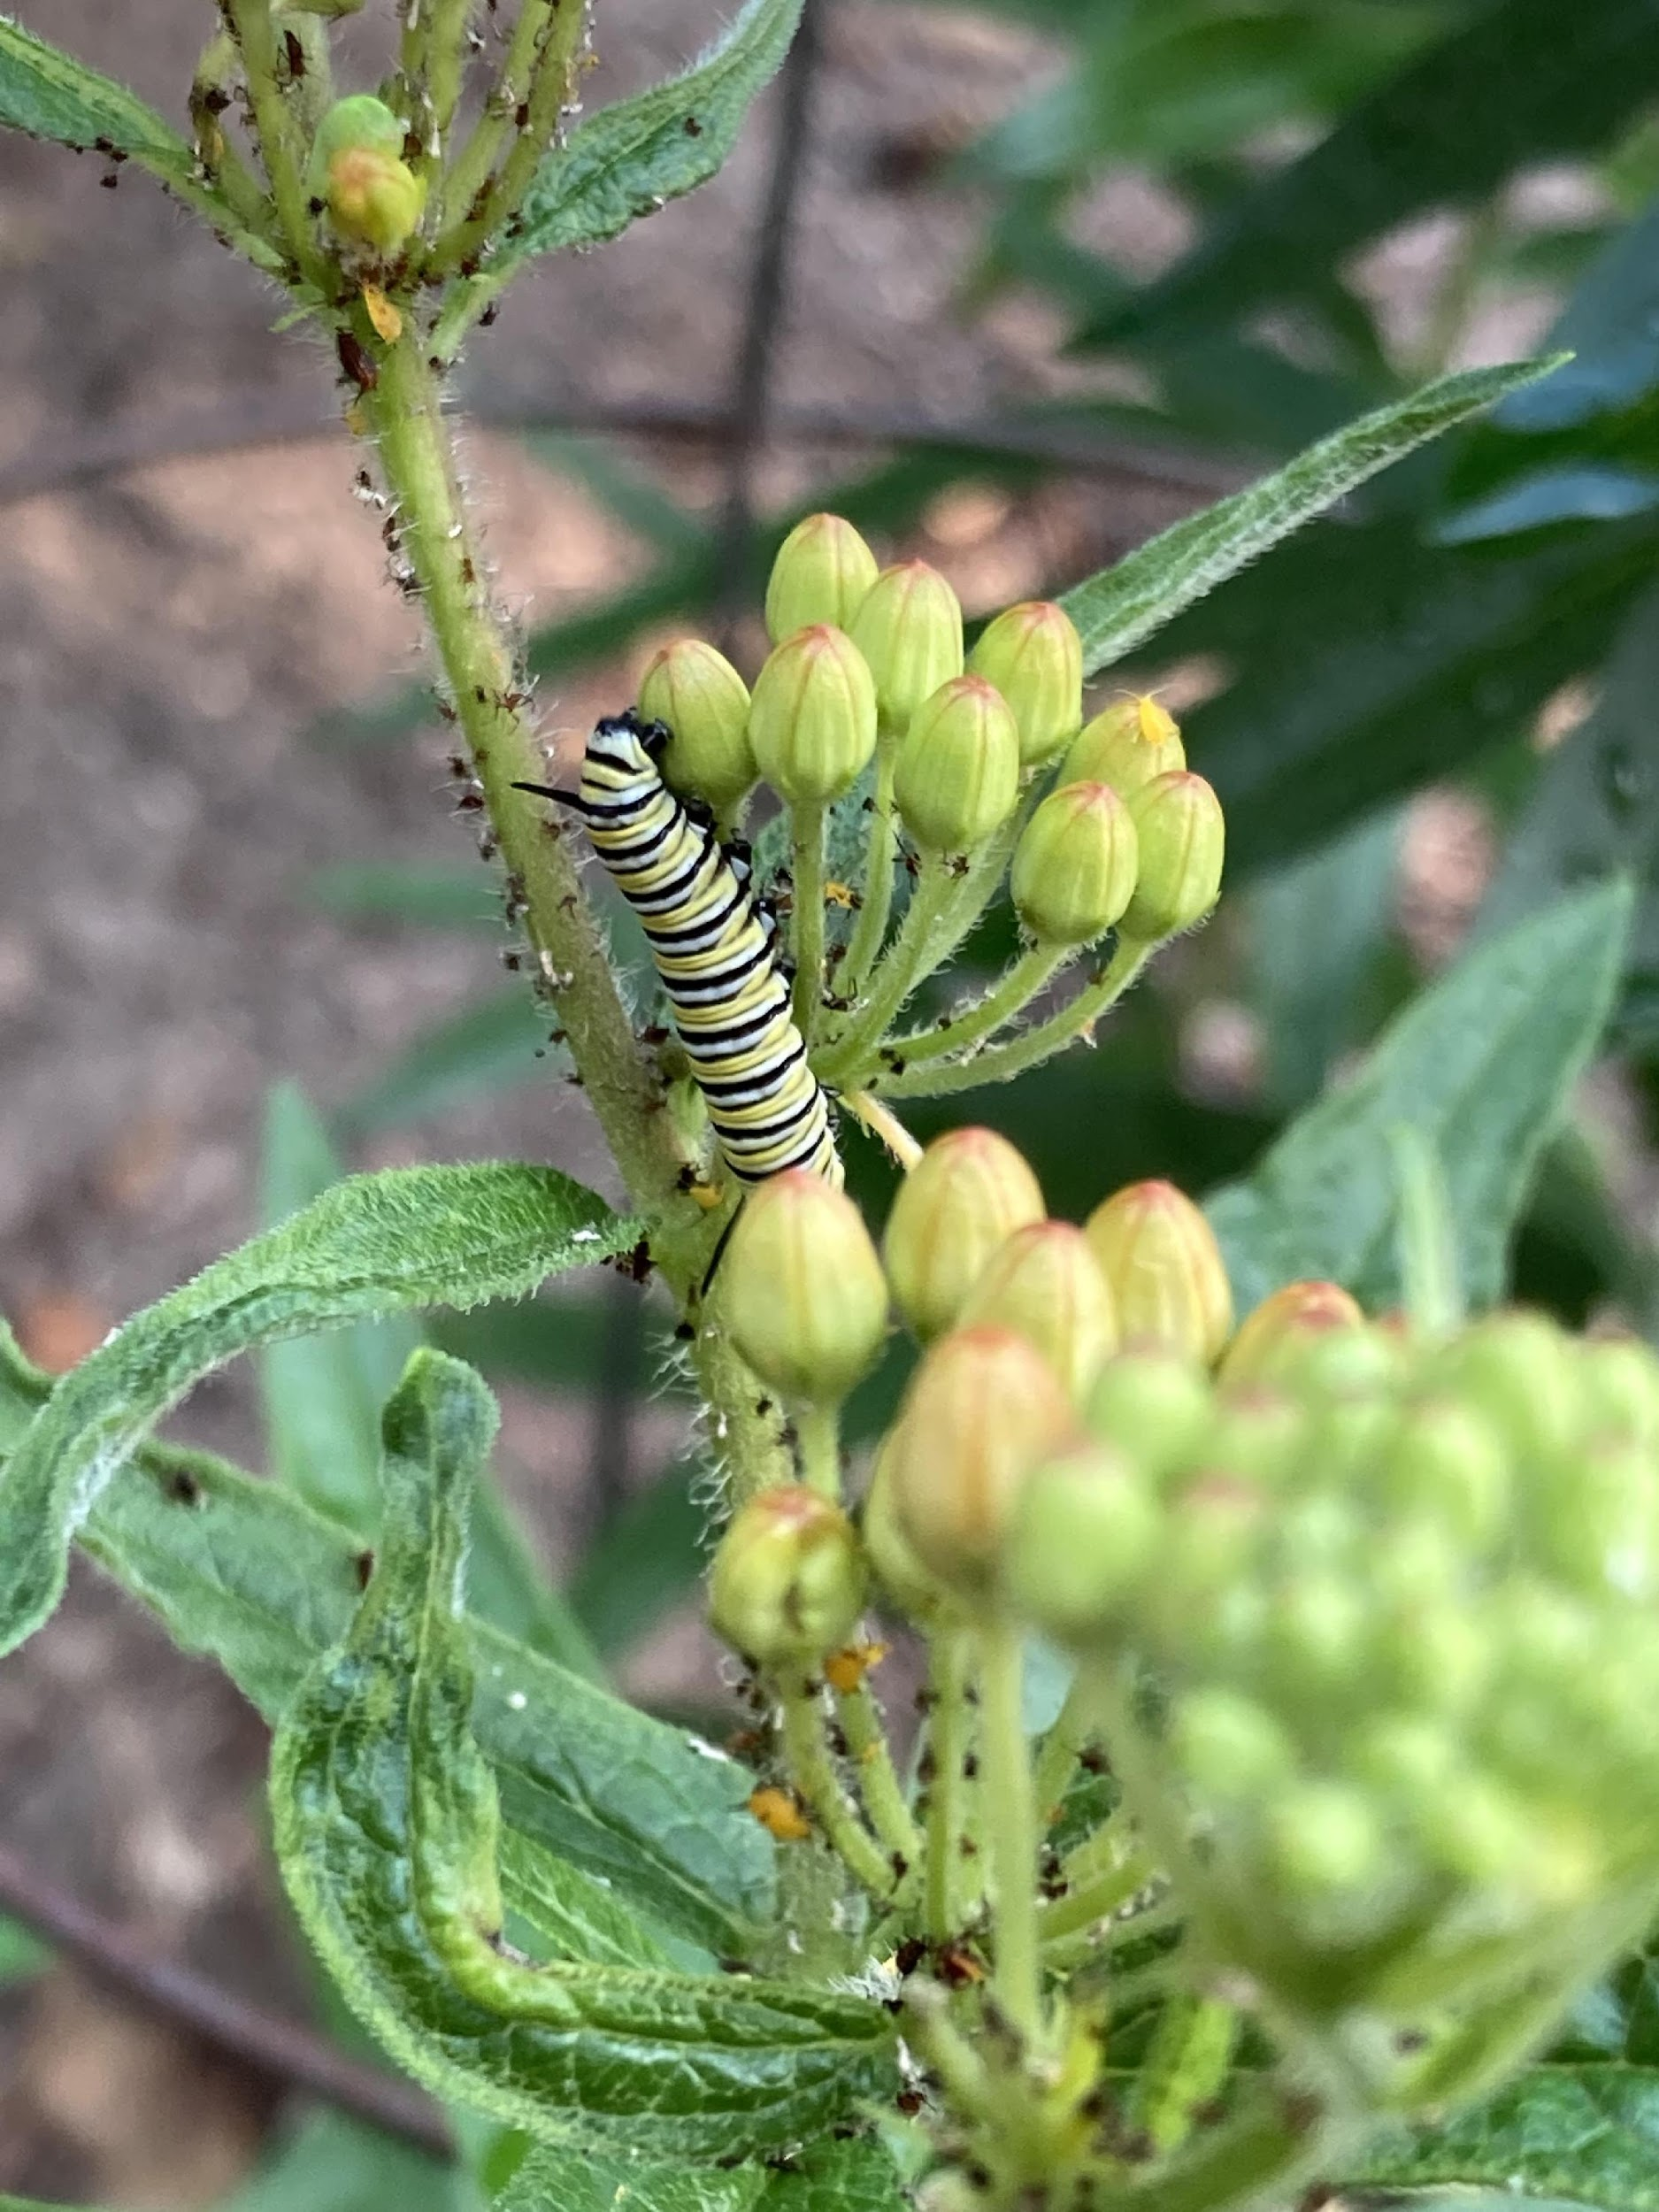
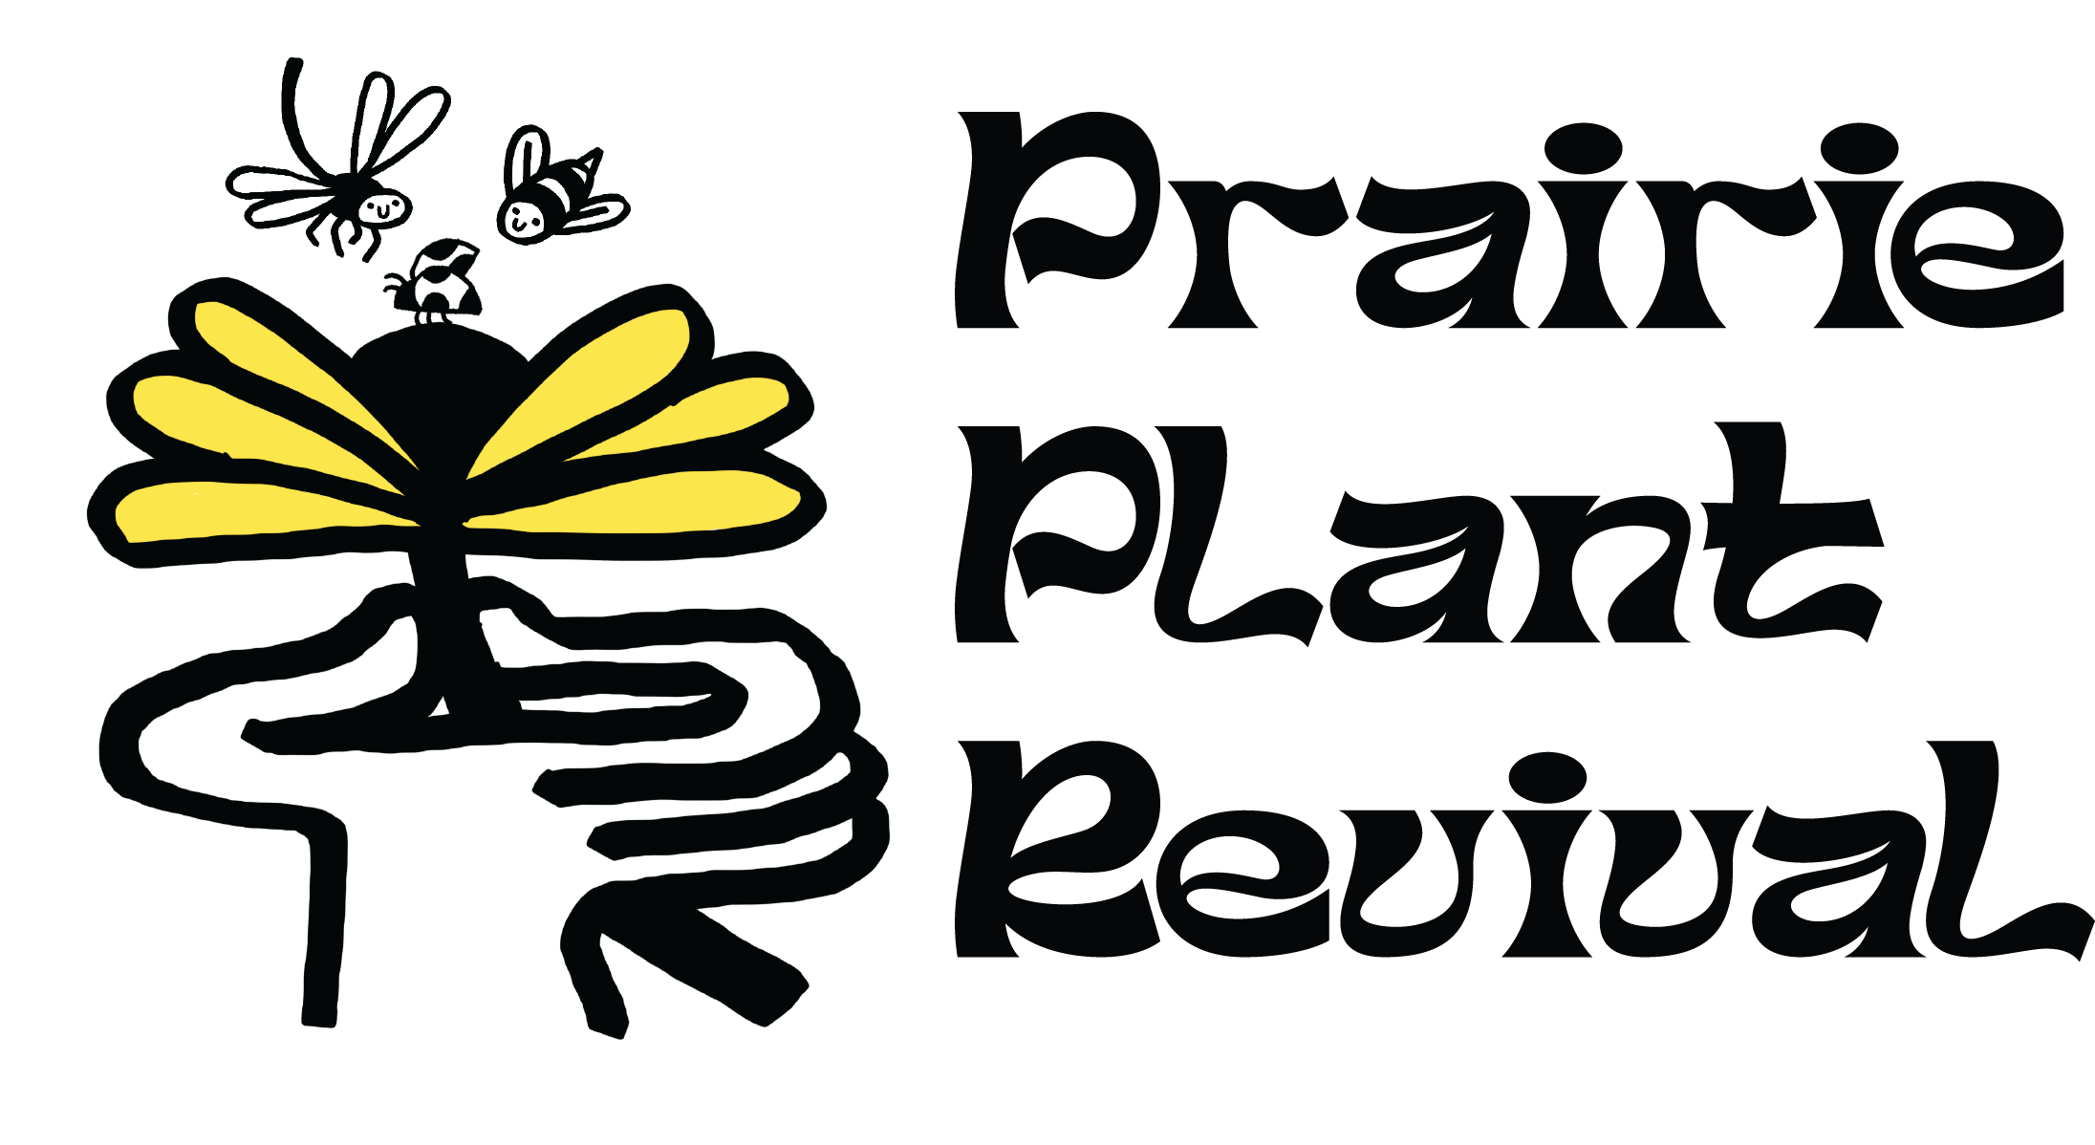
Growing Native
Feeding Nature and Growing Biodiversity
Judy Grimes, February 15, 2026

Slide 2
Growing Native
Sections Overview
What’s so special about natives?
Inviting nature and supporting community.
Start your native garden journey.
Prepare to plant. Click here to skip ahead to Making your plant list & Sourcing Plants and Seeds
Tending to the native garden.

Slide 3
What’s so special about natives?
Native means…
The National Wildlife Federation defines a native plant as a species that has occurred naturally for thousands of years in a region, ecosystem, or habitat without human introduction.
The tall grass prairies of Illinois existed for thousands of years prior to European settlement. Plants and wildlife coexisted and evolved together resulting in a unique symbiotic relationship. The plants provided food and shelter for wildlife and the wildlife propagated the landscape pollinating the plants, spreading the seeds, and grazing on vegetation.
Prior to settlement, the Chicago region had a diverse landscape of prairie, savanna, woodland, forest and wetland.

Slide 4
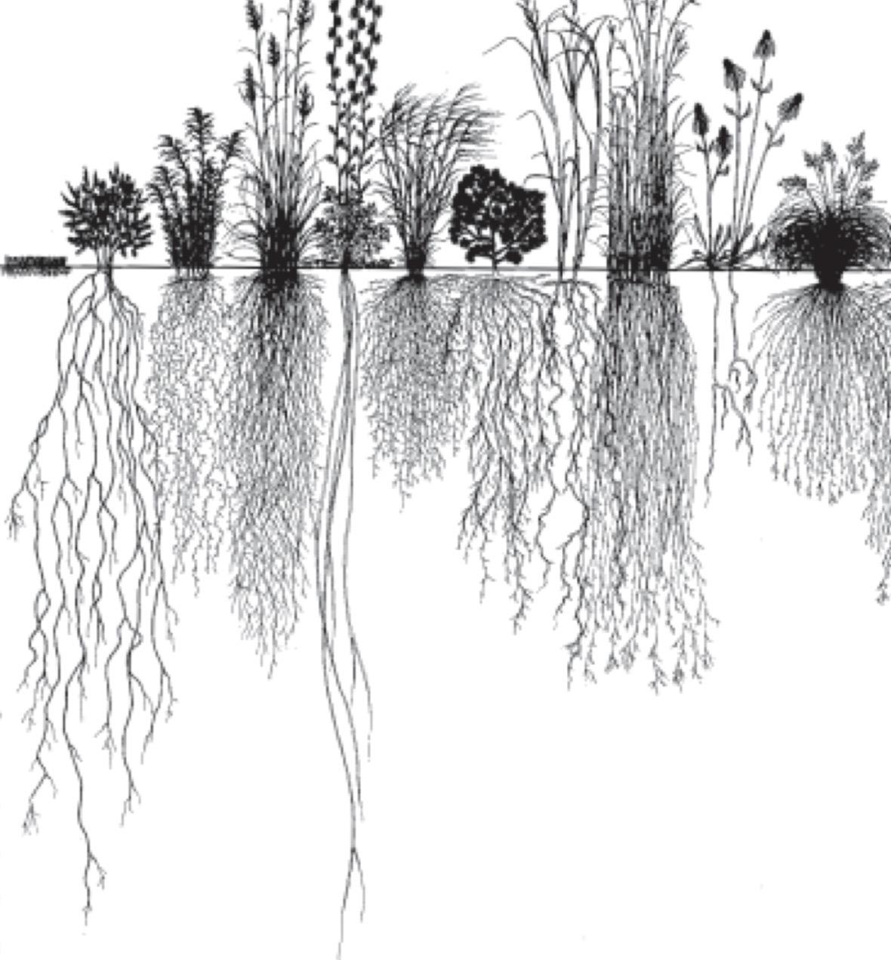
Resilient for survival
Overtime native plants have developed the ability to survive and thrive the extremes of summer heat and winter freezes and extended dry periods.
The long roots improve the water holding capacity of the soil and reduce water runoff.
The deep root system stabilizes the soil and mitigates erosion.
The dense and long roots of native plants hold carbon in those roots and surrounding soil.

Slide 5
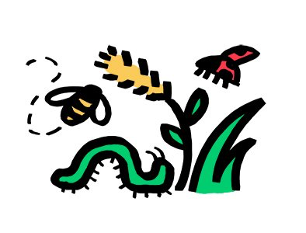
Inviting Nature and Supporting Community

Slide 6
Flora and Fauna Relationship
Host plants provide specific nutritional needs for insect specialists to complete their life cycles. This is especially important for butterflies and moths.
Native bees are specialists or generalists. The specialists forage on the nectar and pollen of specific flowers or plant families. Generalists forage on many different plant species.
Keystone plants have an essential role in the food web. These plants have a large impact on the ecosystem relative to their abundance. Research by entomologist Doug Tallamy shows that 14% of native plants support 90% of butterfly and moth species. The National Wildlife Federation has a database of Keystone Plants by Ecoregion. https://nativeplantfinder.nwf.org/

Slide 7
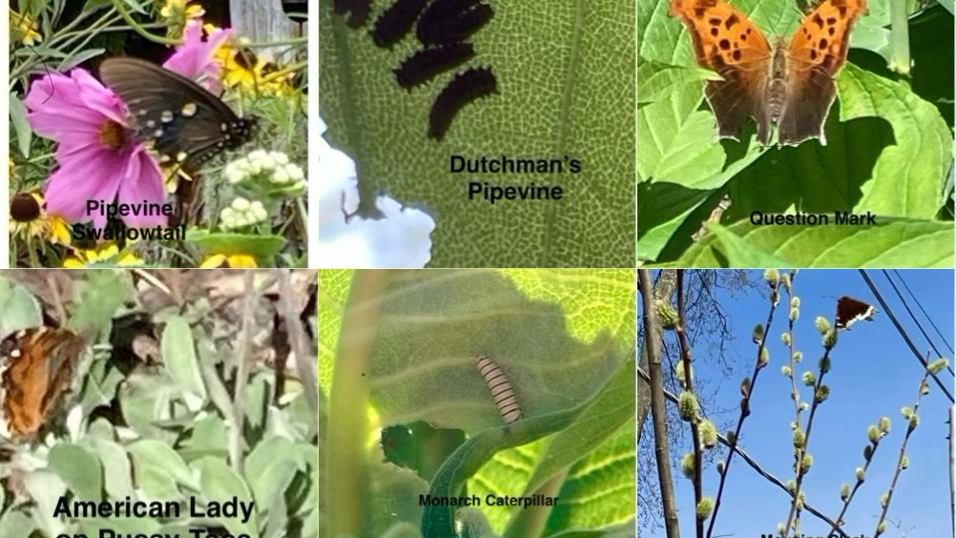

Slide 8
Planting for Community
Diversity matters to nature. Planting native is supporting community. Including trees and shrubs in the landscape is as important as planting forbs and grasses. Diversity is the foundation of a healthy ecosystem.
Blooms through the growing season are critical to support a diversity of insects and wildlife. Spring flowering plants, trees and shrubs provide nutrition for emerging insects. The summer flowers provide nectar and pollen for another group of foraging insects. The late bloomers are a source of nutrition for migratory birds and insects and important for overwintering species.

Slide 9
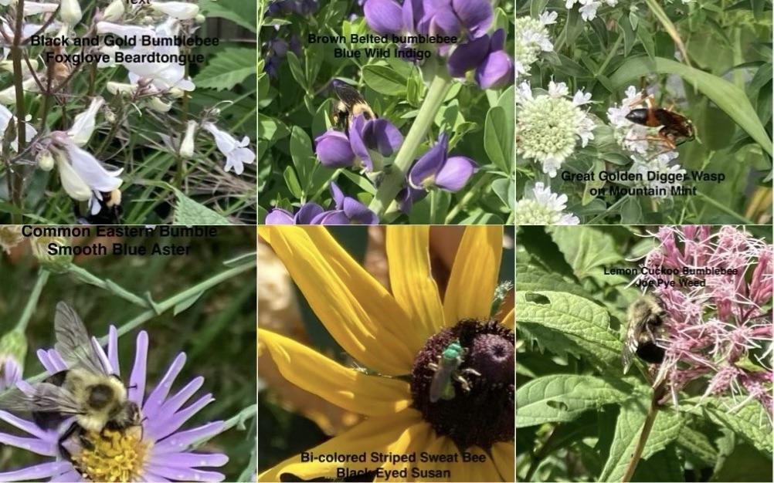

Slide 10

Start your native garden journey

Slide 11
Right Plant, Right Place
The right plant in the right place is the first and most important step. Knowing the sun availability and soil dryness level determines which plants will grow and thrive in your sun and soil conditions.
Full shade - four or less hours of direct sun.
Part Sun/Part Shade - four to six hours of direct sunlight.
Full Sun - six or more hours of direct sun.
What is your goal - aesthetics, attract pollinators, seasonal interest, low maintenance, community?

Slide 12
Prepping the growing space
Limit competition and remove weeds, invasive species or turf grass from your garden space.
Sheet mulching, an easy process that does not use chemicals but requires patience. (My preferred method);
Hand pulling weeds and using a sod cutter to remove turf grass.
Chemicals to kill the vegetation and/or grass. (Harmful to the environment and surrounding wildlife)
Don’t till the soil. Tilling damages the soil structure and brings weed seeds to the surface where they will germinate and quickly fill the new bed with fresh weeds.
No fertilizer is necessary. Native plants are accustomed to the clay soils of northeast Illlinois.

Slide 13
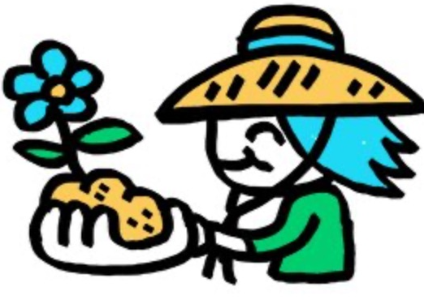
Prepare to Plant

Slide 14
Consider the design
Plant characteristics to consider: color, height, width, bloom times, vigor, texture, pollinator benefits, four season interest.
Aggressive natives may out compete other species and best used in large areas.
A wild prairie garden appearance looks great for larger spaces and is easily started from seed.
The intentional and neat garden bed is good for smaller spaces. Establish the small garden with plugs or first year plants.
Trees and shrubs provide structure and create a layering affect. Grasses and sedges provide structure and texture.

Slide 15
Making your plant list
You know the sun and soil conditions and your goals. Before you make your plant list, research the plant characteristics. Some resources:
Prairie Moon Nursery website prairiemoon.com
“The Gardener’s Guide to Prairie Plants” by Neil Diboll & Hilary Cox
Citizens for Conservation Native Plant Data Base https://nativeplants.citizensforconservation.org/
Illinois Wildflowers https://www.illinoiswildflowers.info/
DuPage Wild Ones https://dupage.wildones.org/
Kane-DuPage Soil & Water Conservation District https://kanedupageswcd.org/kd/
Loyola Retreat & Ecology Campus https://www.luc.edu/retreatcampus/programs/

Slide 16
Sourcing Plants and Seeds
Select plants and seeds grown within 100 miles of your ecoregion. These plants are adapted to your local growing conditions.
Spring native plant sales are great for planting plugs of flowering species, sedges, and grasses. Fall native plant sales offer a variety of trees and shrubs native to the Chicago region.
Illinois Native Plant Society https://www.illinoisplants.org/native-plant-sales/
Wheaton Park District https://wheatonparkdistrict.com/events/native-illinois-plant-sale/
DuPage County Forest Preserve https://www.dupageforest.org/things-to-do/calendar-of-events/native-plant-sale
Possiblity Place Native Plant Nursery, Monee https://possibilityplace.com/
Prairie Plant Revival (Judy Grimes) prairieplantrevival.com

Slide 17
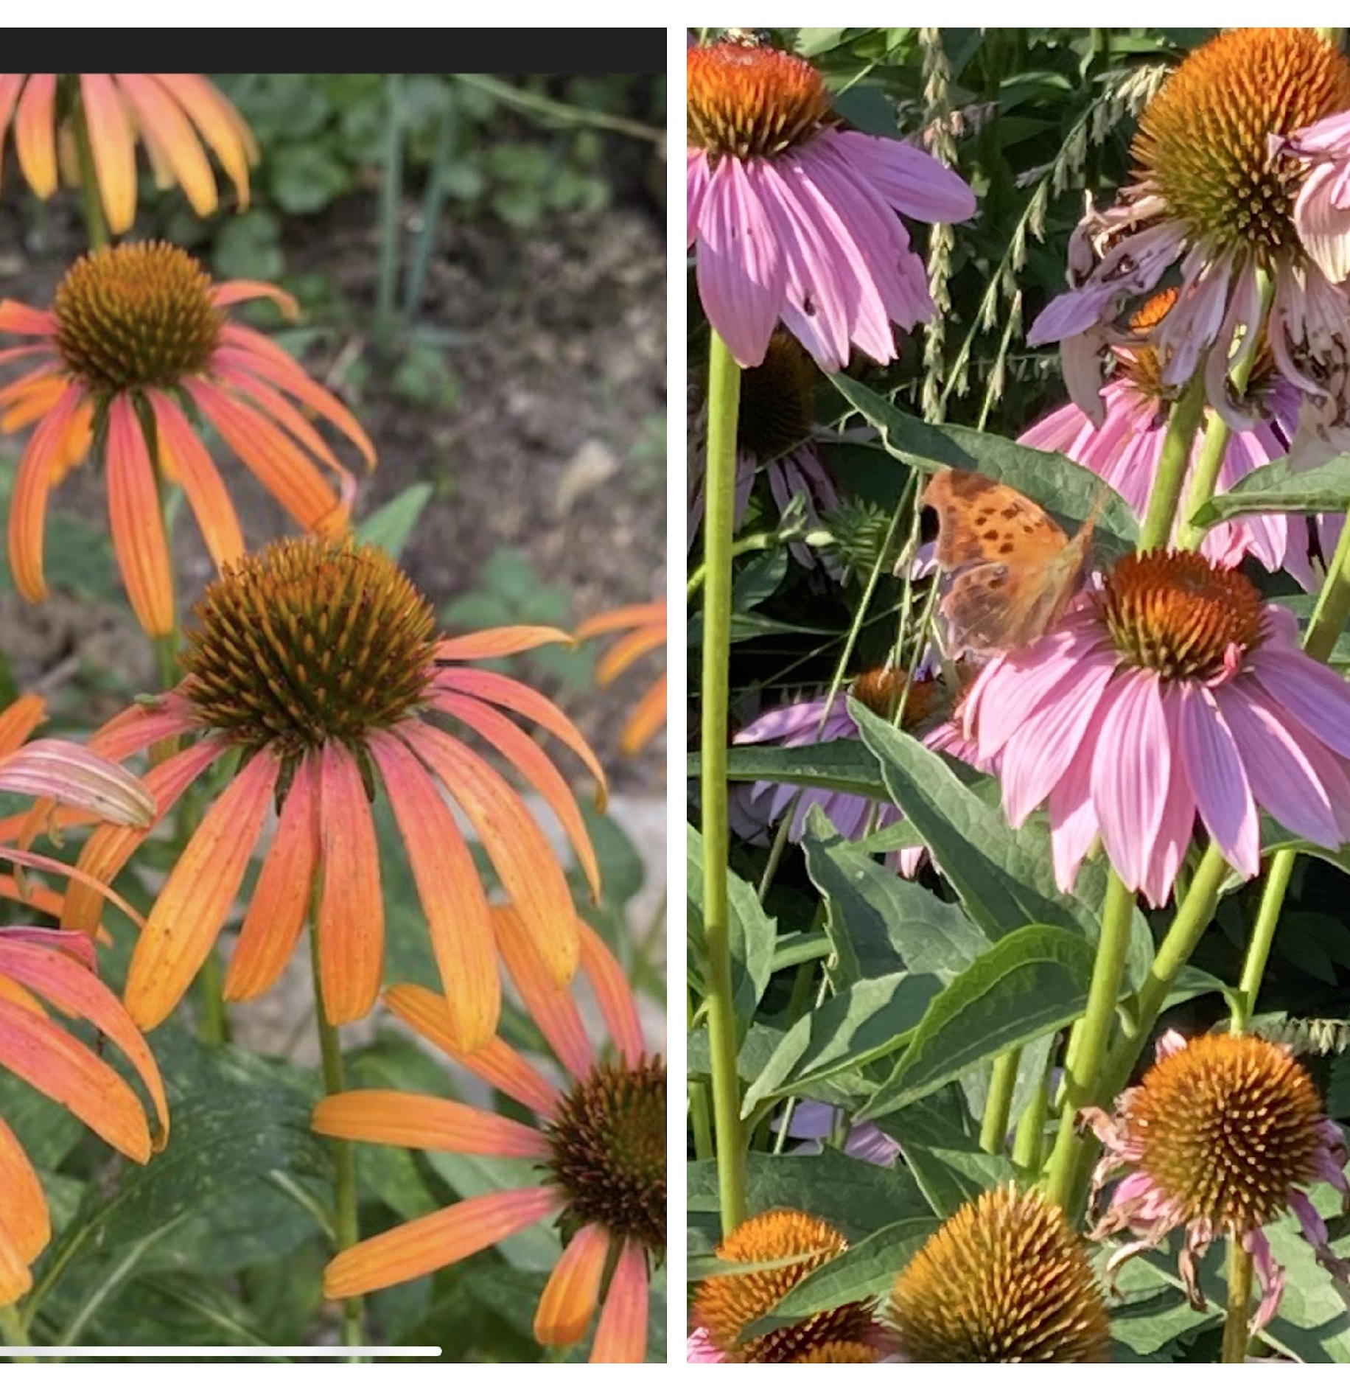
Nativar v Native
Nativars are not the true native species. It is a cultivar of a native species and usually propagated vegetatively.
Most big box stores and commercial nurseries don’t sell true native species or only a small variety of natives.
Echinacea ‘Cheyenne Sprit’ is a nativar. Echinacea purpurea is native.

Slide 18
Into the Ground They Go
Planting with plugs and first year plants speeds up the process for establishing your garden and can be planted any time before the ground freezes.
Fall planting usually results in healthier, better established plants the following season.
Starting from seed is a good option for large spaces or if want the “wild” appearance. Most native seeds require a period of cold moist stratification. Seeding will be less expensive but will take longer for the final garden result.
You can winter sow seeds in a container and plant out first year plants during the growing season.

Slide 19
Planting Continued…
Plant three or more of the same species together. Odd numbers are best for visual effect and for wildlife/pollinators.
When planting seedlings or plug sized plants, space 8 to 10 inches apart. This provides room for the plant to mature but allows for density to limit weeds and promote community.
A mix of flowering plants, sedges, and grasses with different leaf texture and structure tends to be more pleasing to the eye. Trees and shrubs provide wildlife shelter and food and visual layering.
Put tall plants in the back or center of the bed, Place the shortest plants in the front for edging.
Fill in open space with annuals such as zinnias. The open spaces will disappear as plants mature.

Slide 20
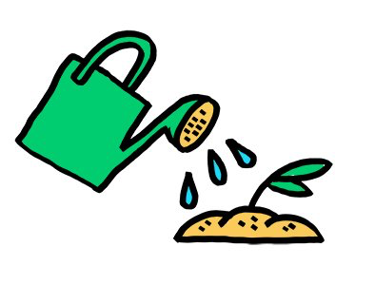
Tending to the Native Garden

Slide 21
Tips for Managing Natives
The first year, water newly established plants several times a week for the first month and monthly thereafter unless there is a drought. Once the plants are established (usually year two) you can reduce the watering unless there are extended dry periods.
Continue to pull weeds and invasive plants that creep into the bed.
Soil amendment is not needed nor recommended.
Protect young plants from hungry wildlife.

Slide 22
More on Management
Mulching is a good practice to retain soil moisture and control weeds. Leaf mulch is best and wood mulch is ok. Do not mulch up to the plant stems.
Don’t worry if you don’t see any plant growth in March, April or even May. Some native species, are slow to emerge. It depends on the species, the weather, and the microclimate.
In the Fall, let the stems and leaves remain for seasonal interest and to provide shelter for over-wintering butterflies, bees and insects. The remaining seed heads are food for birds and other wildlife and will self sow and replenish your garden the next garden season.
The first year the native garden sleeps, the second year it creeps, the third year it leaps!

Slide 23
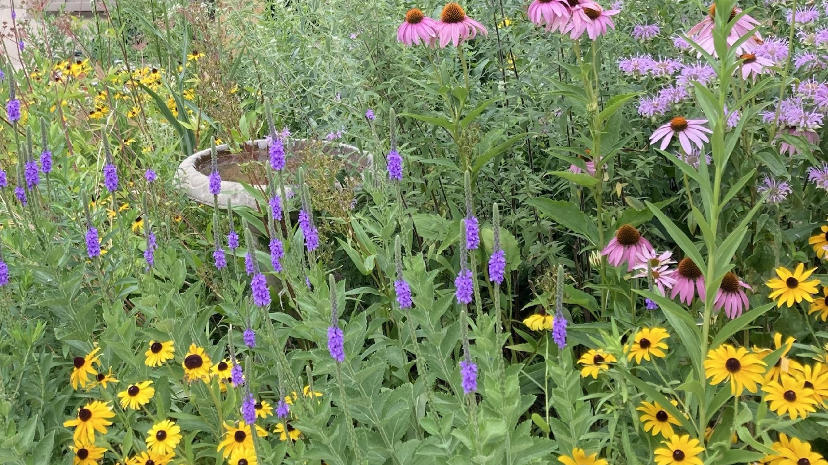

Slide 24
Thank you.

Slide 25
prairieplantrevival.com • prairieplantrevival@gmail.com

